Slide 1
MOVREV
Soorya.k

Slide 2
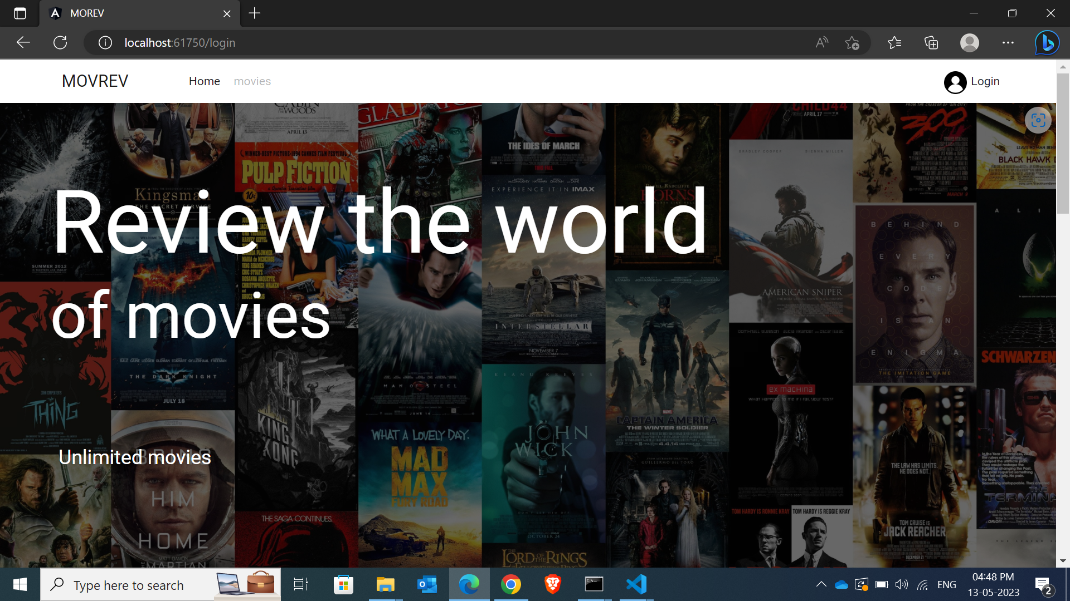
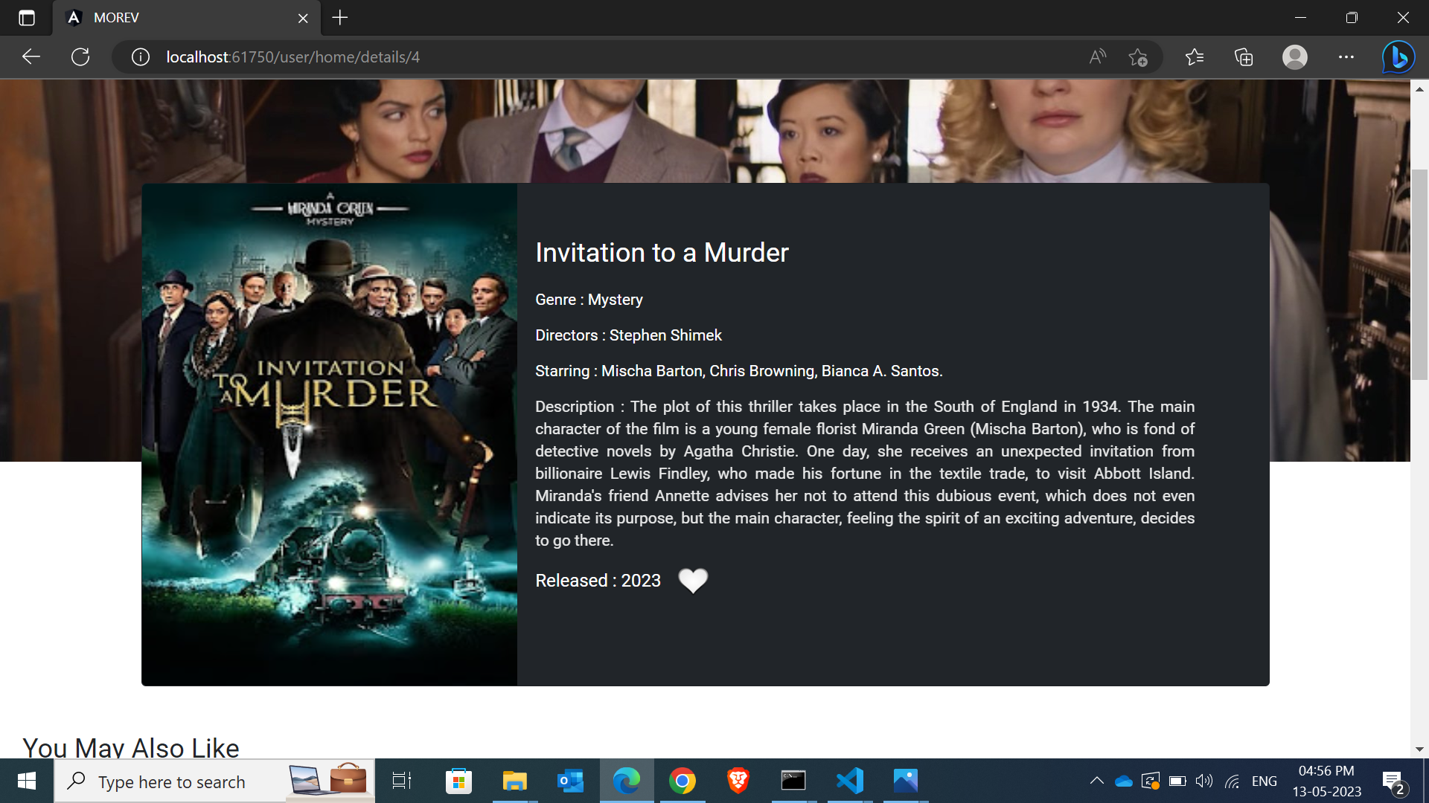
Movrev is a movie review app through which we can review each and every movie displayed in the app

Slide 3
modules
Admin
Shared
User

Slide 4

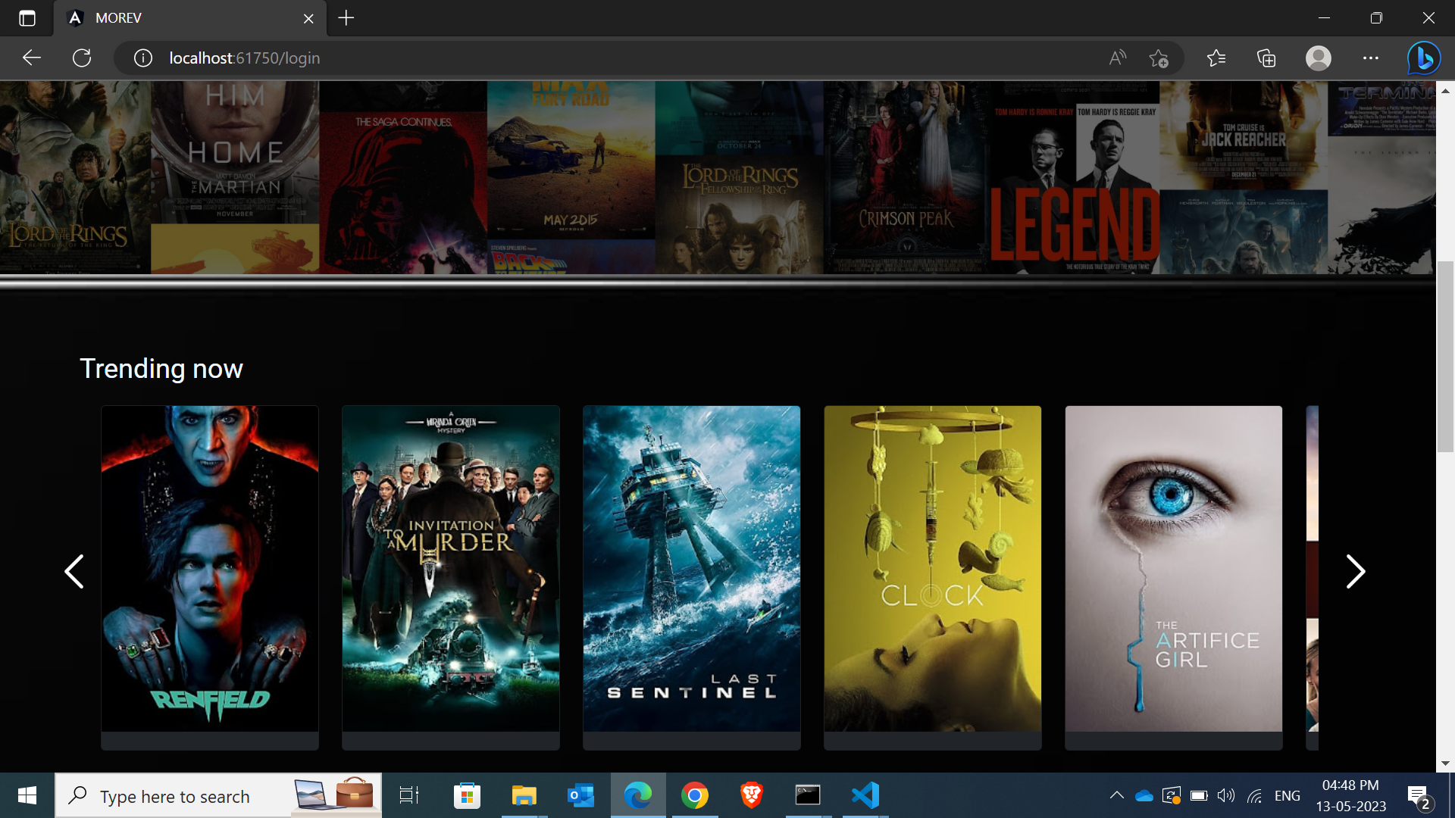
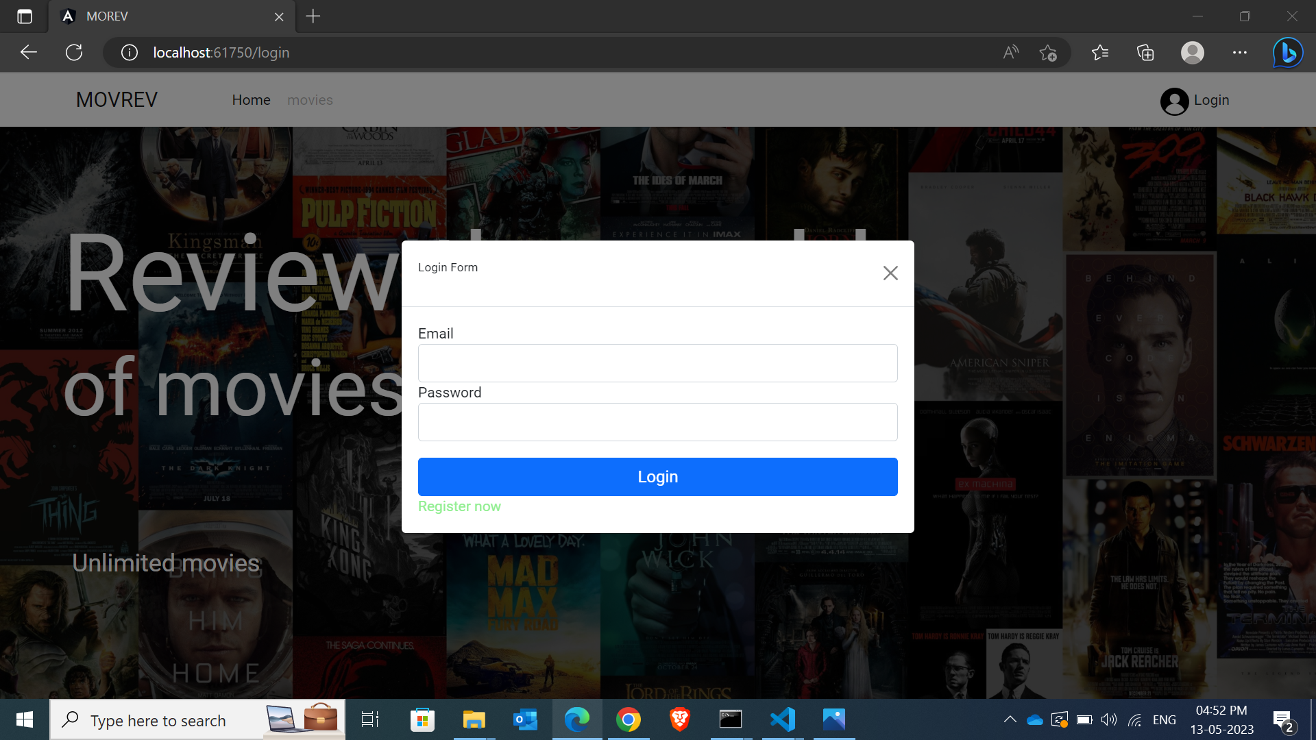
Concepts implemented : custom directive – Scroll (which on clicking indicates the user to login to the app). forms-ngModel. Bootstrap. Modal. Navigation.
Subtitle

Slide 5
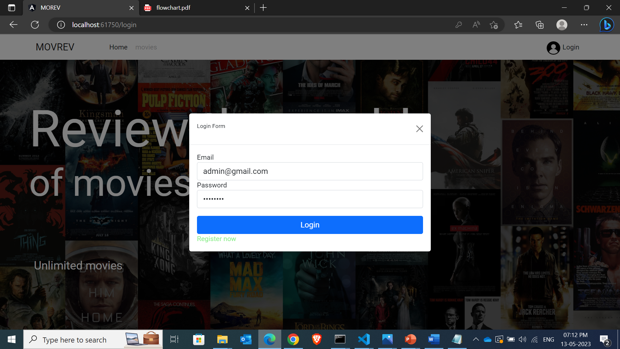
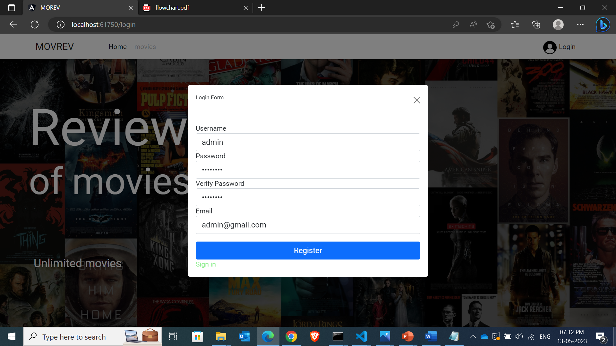

Slide 6
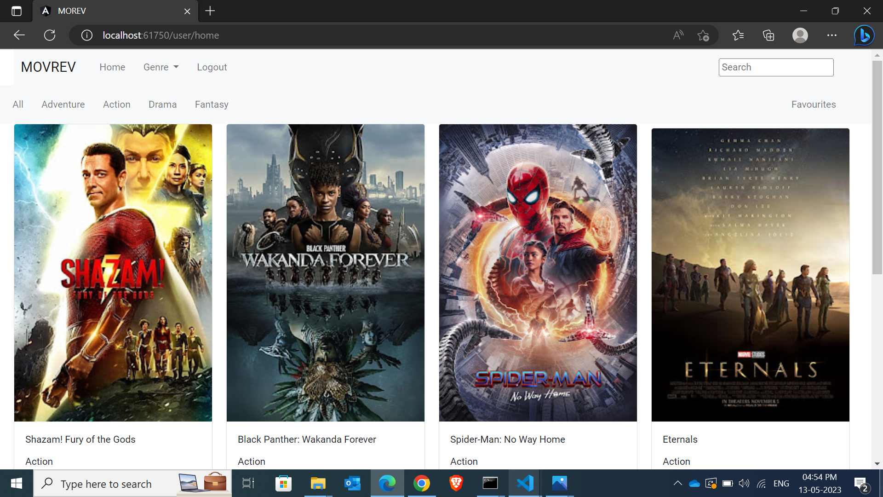
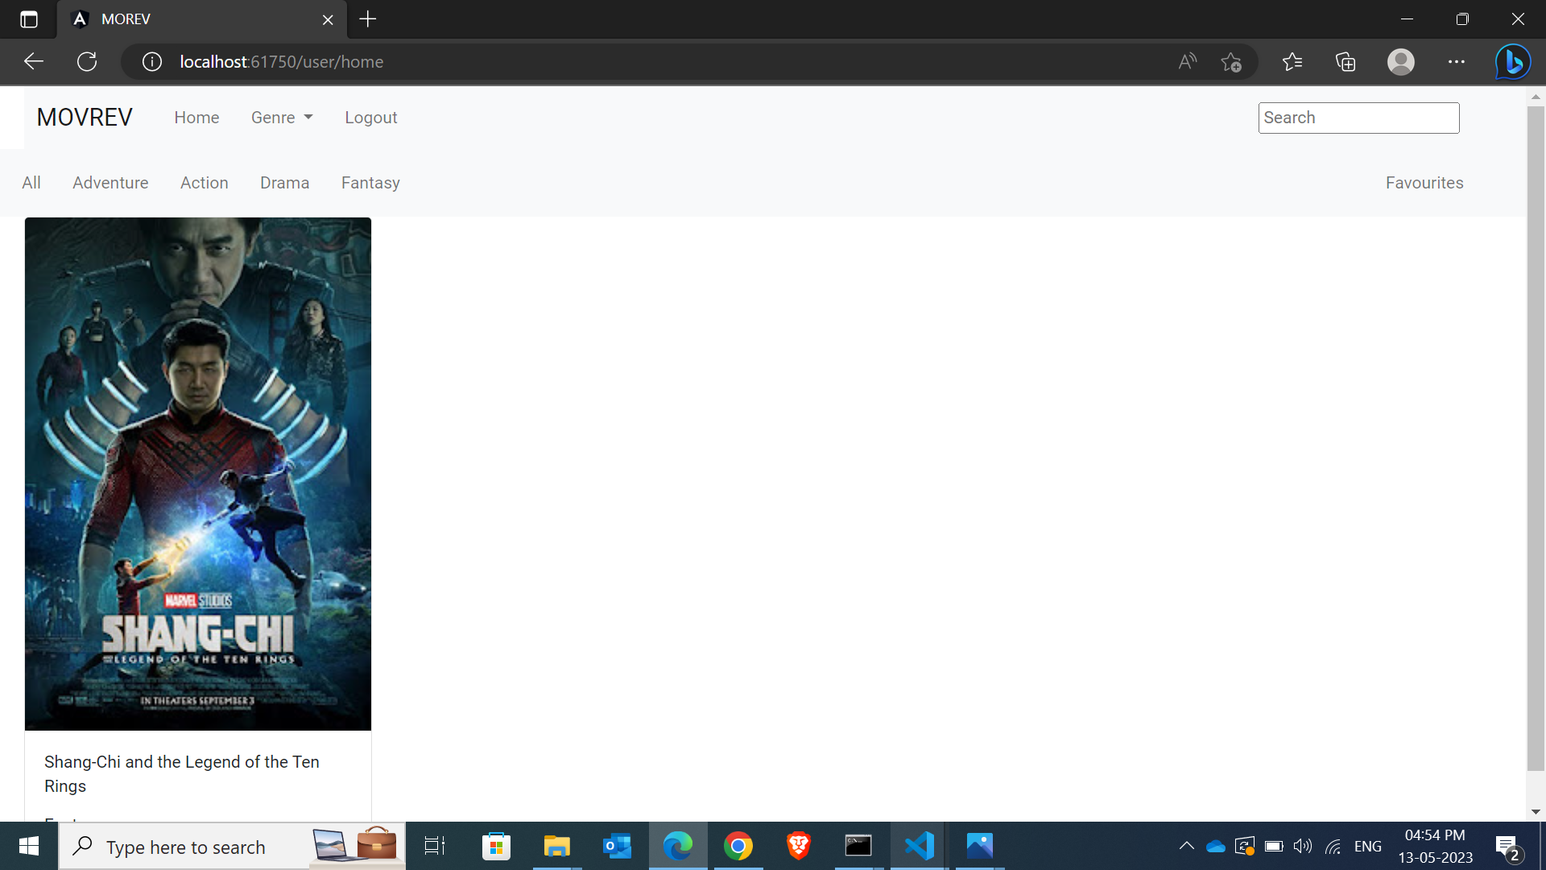
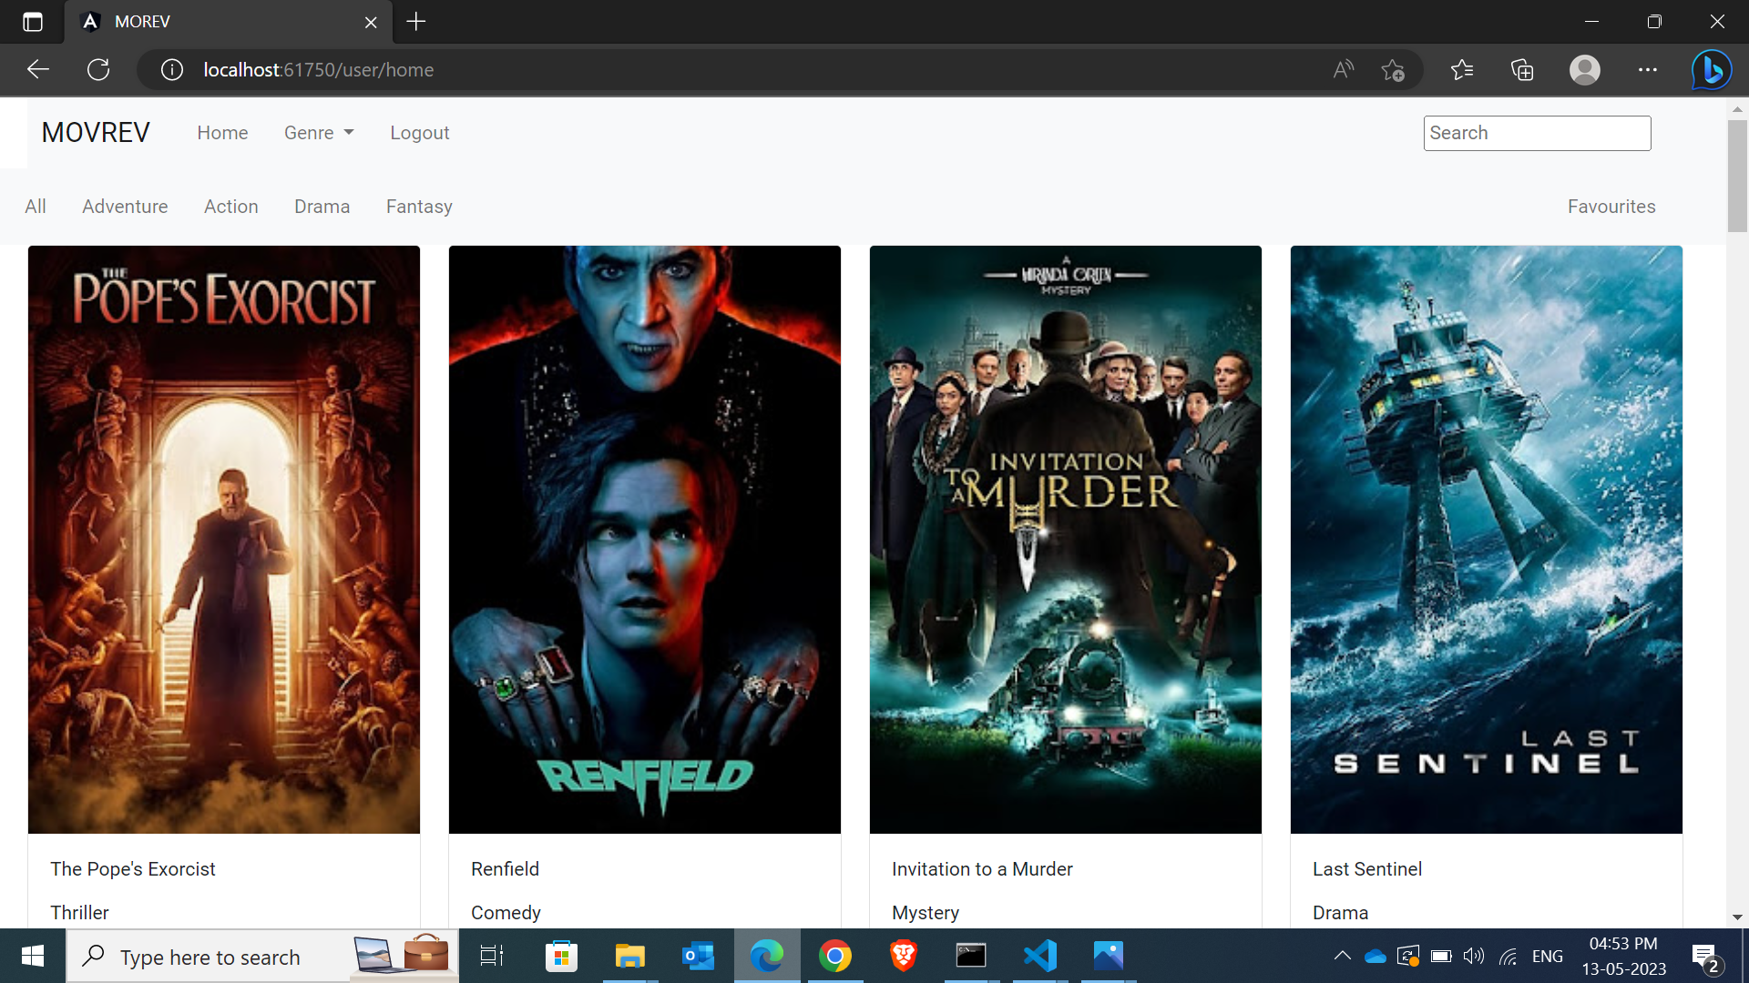
Concepts implemented
Service
pipes
Navigation
Here we choose the genre we want

Slide 7
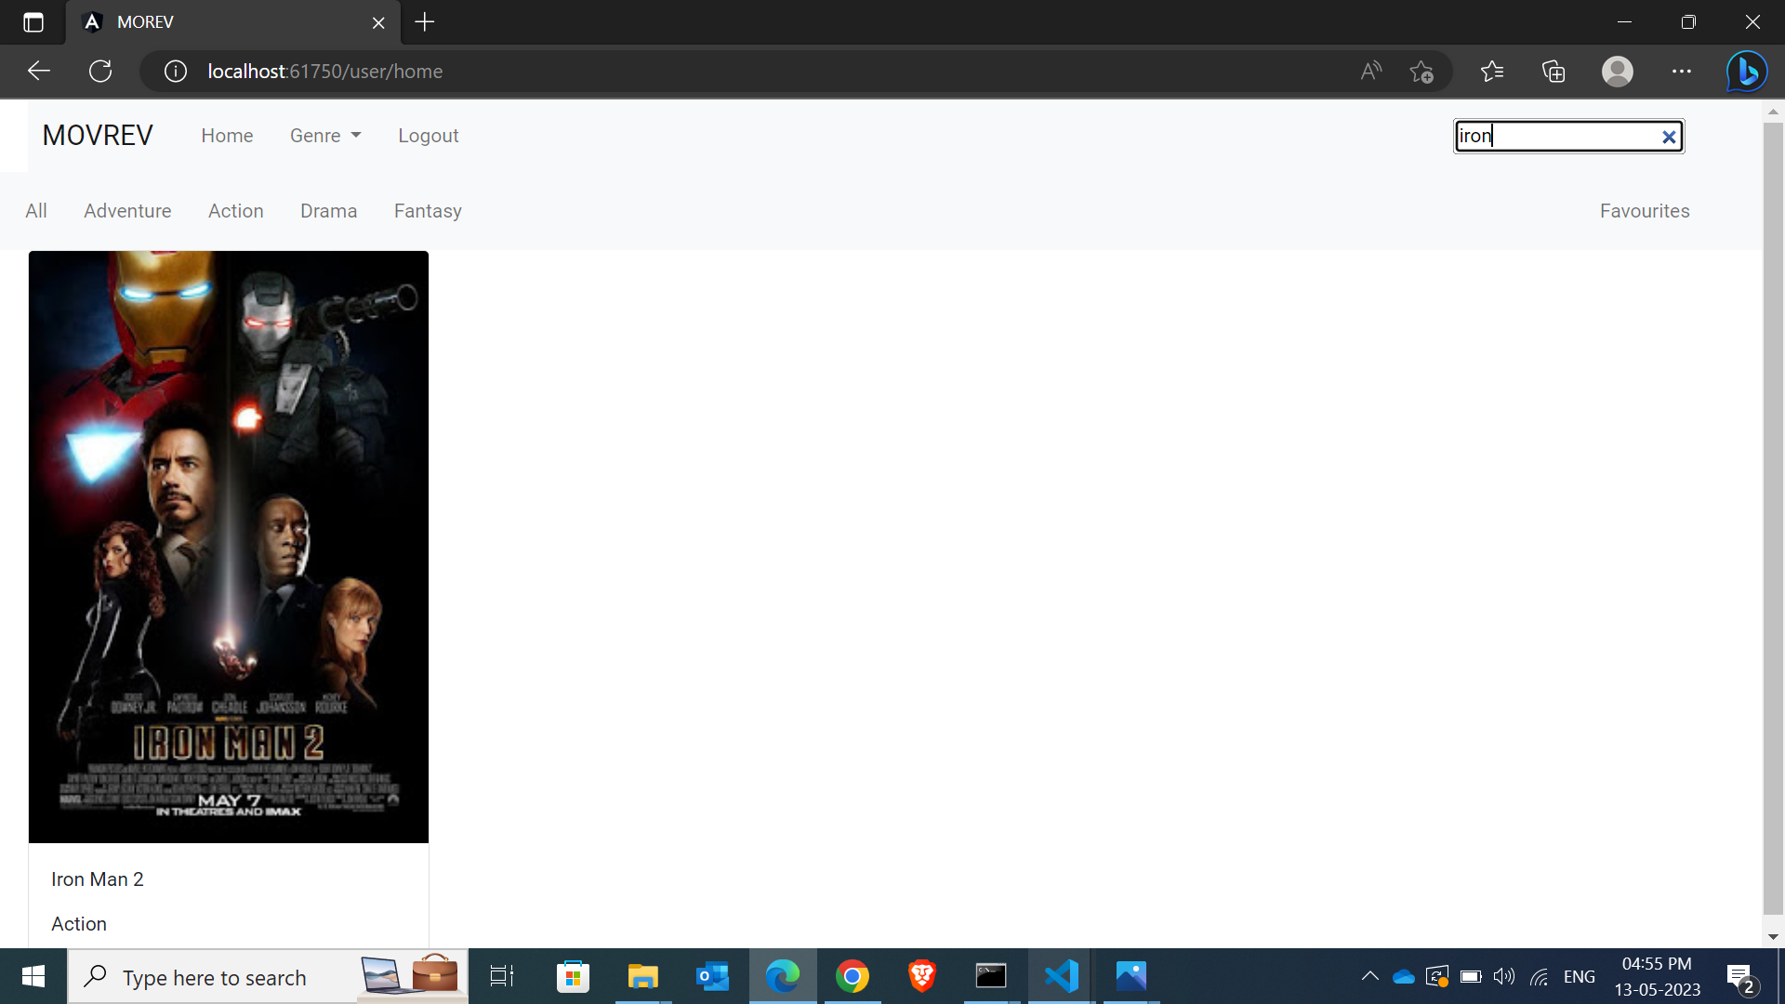
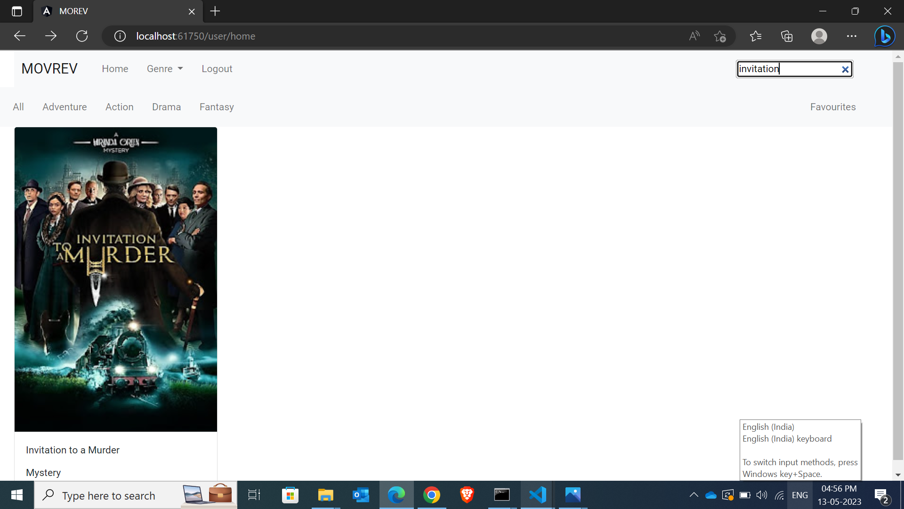
Concepts implemented
pipes
Here we can search in the search bar and we get the results

Slide 8
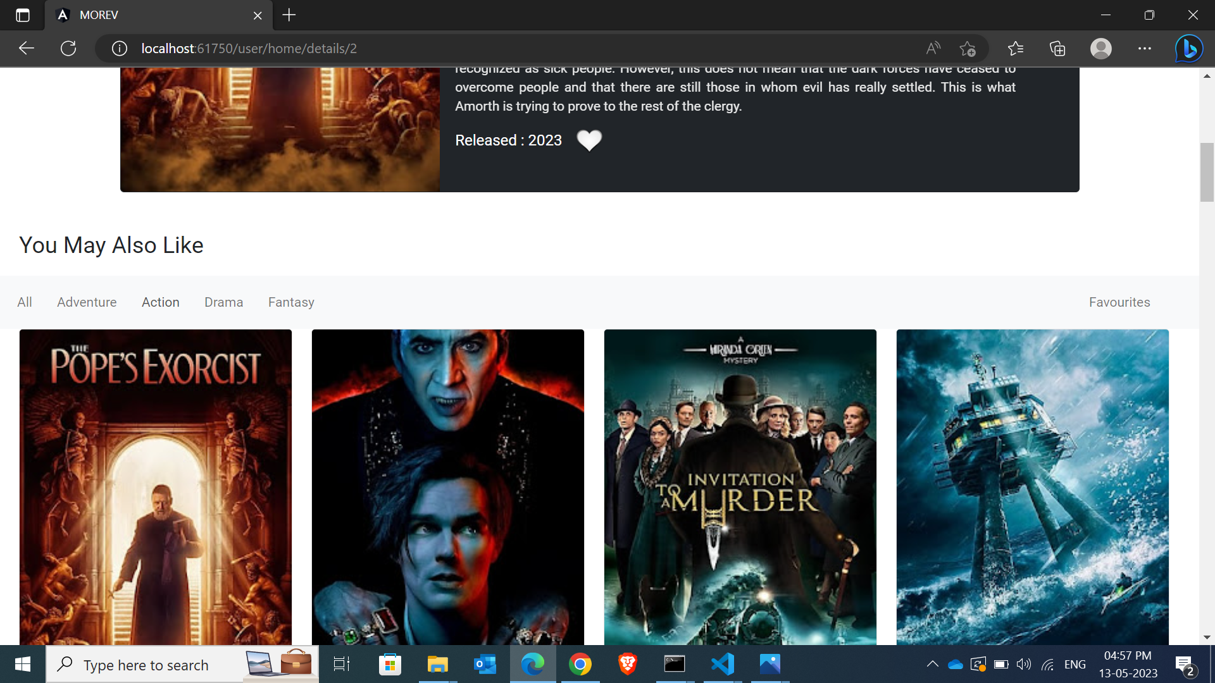
Concepts implemented
navigation
On clicking the movie we get directed to the details page. Here we can also see the suggested list of movies

Slide 9
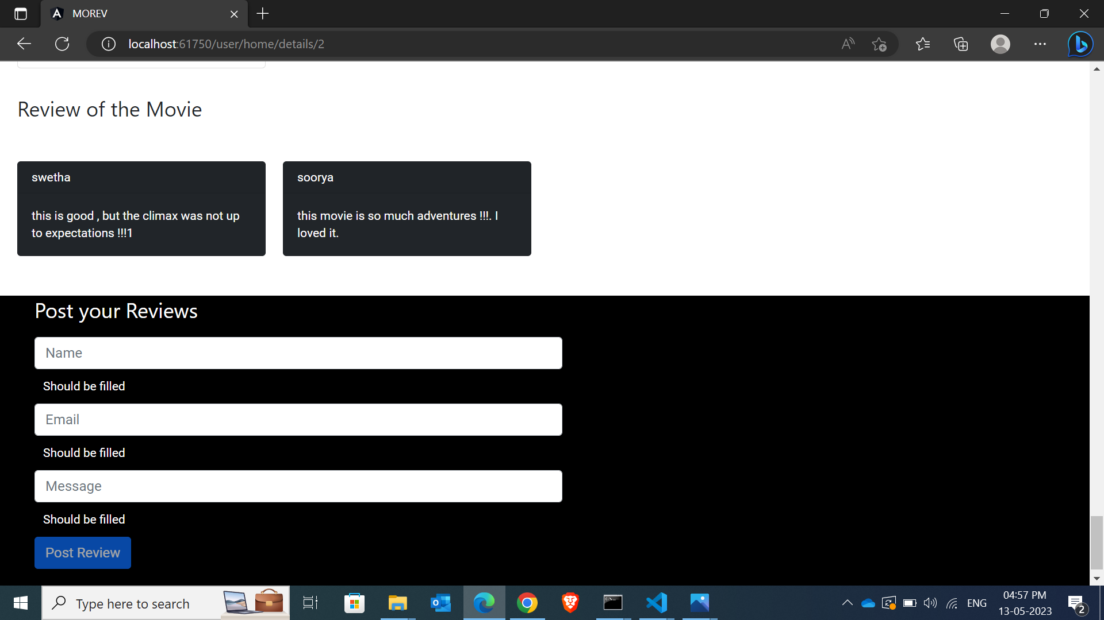
Concepts implemented
Forms
Validation
Service
bootstrap
Here we can fill the form and give review to the particular movie individually.

Slide 10
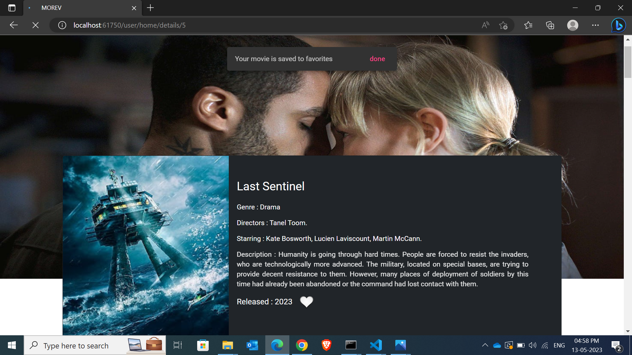
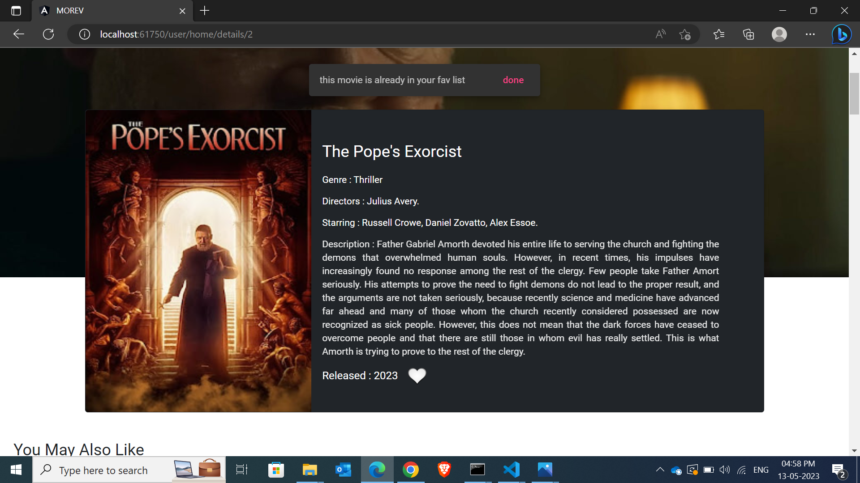
Concepts implemented
Navigation
Service
On clicking the heart symbol the movie gets added to the favourites list . If the movie is already added in the favourites list means a snackbar appears indicating “the movie is already in the fav list ” else it displays “your movie is saved to favourites”

Slide 11
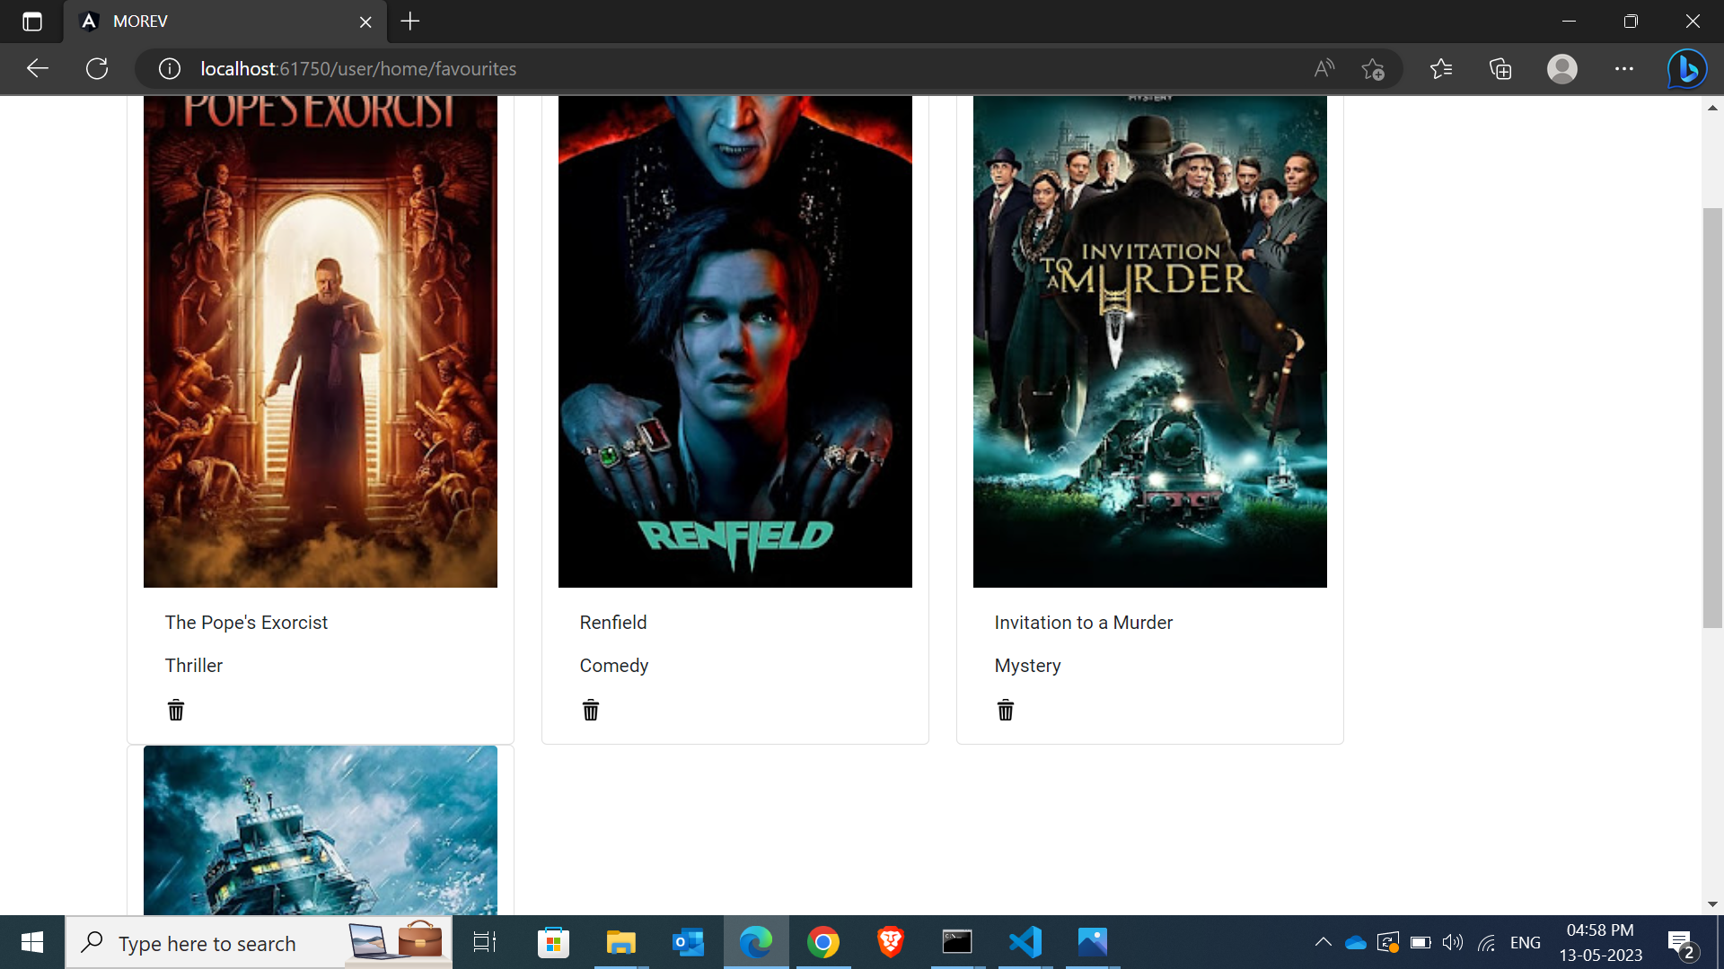
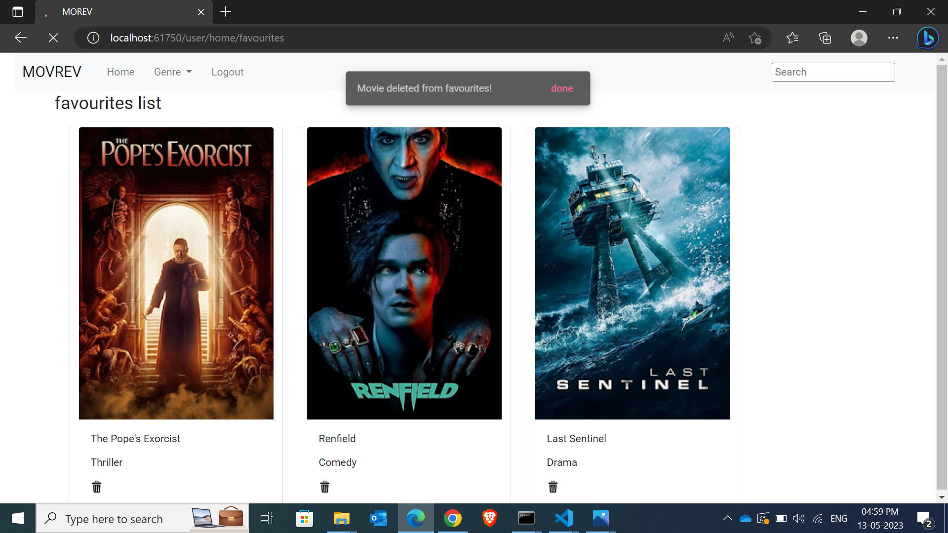
Concepts implemented
Navigation
Service
Pop up
We can click on delete icon to delete the movie from fav list

Slide 12
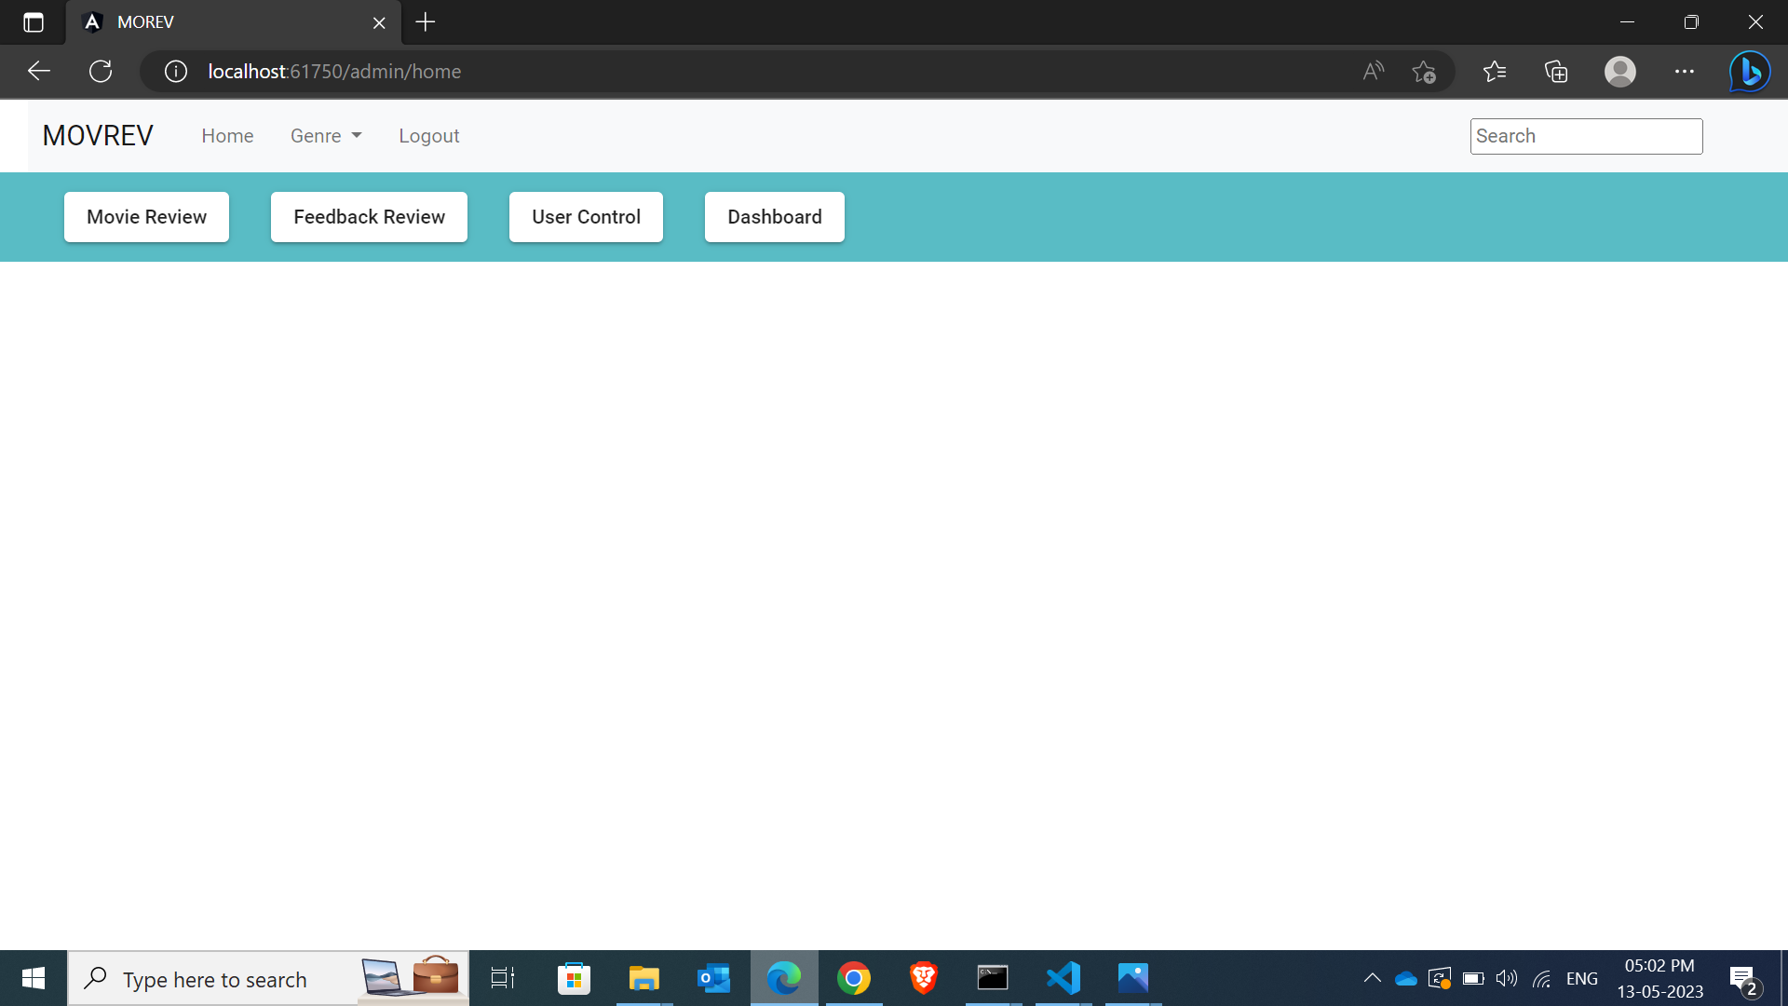
Concepts implemented
Navigation
This is the Admin page

Slide 13
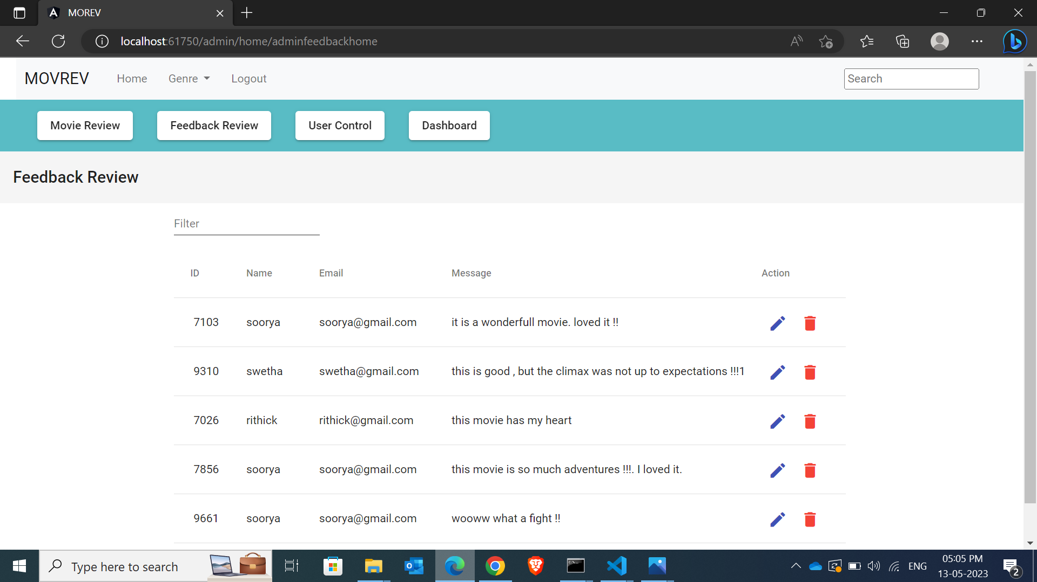
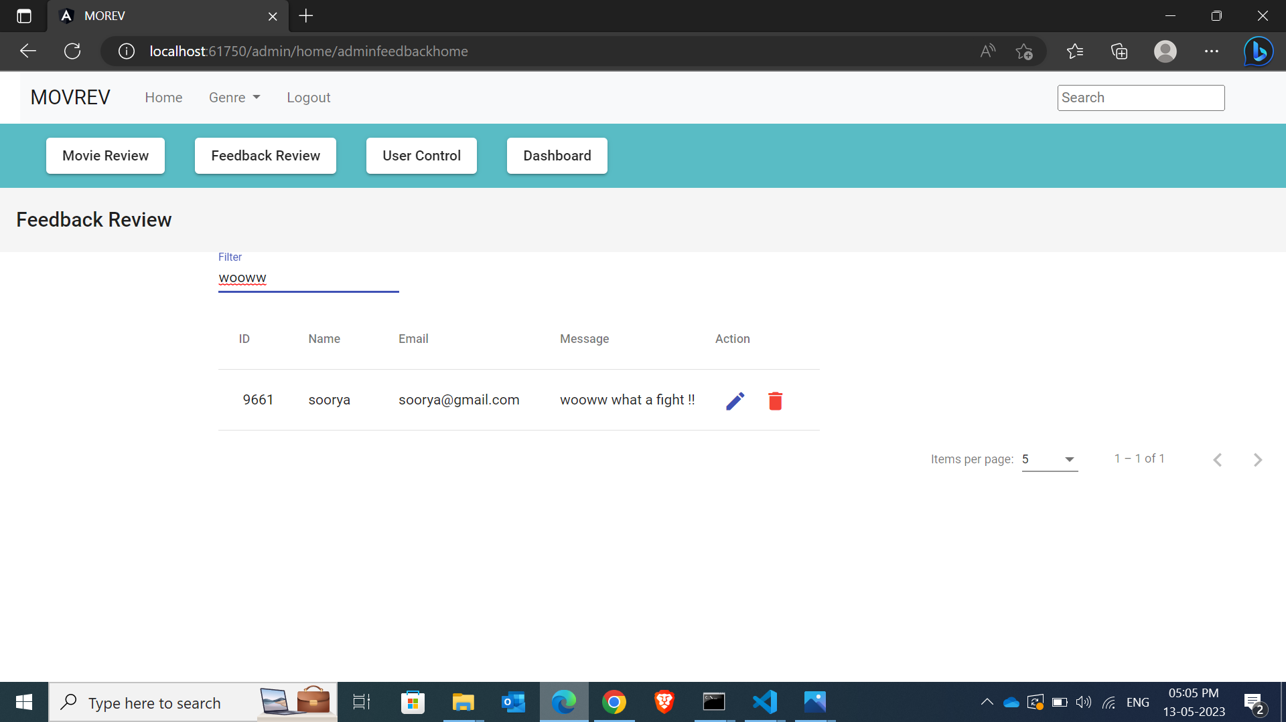
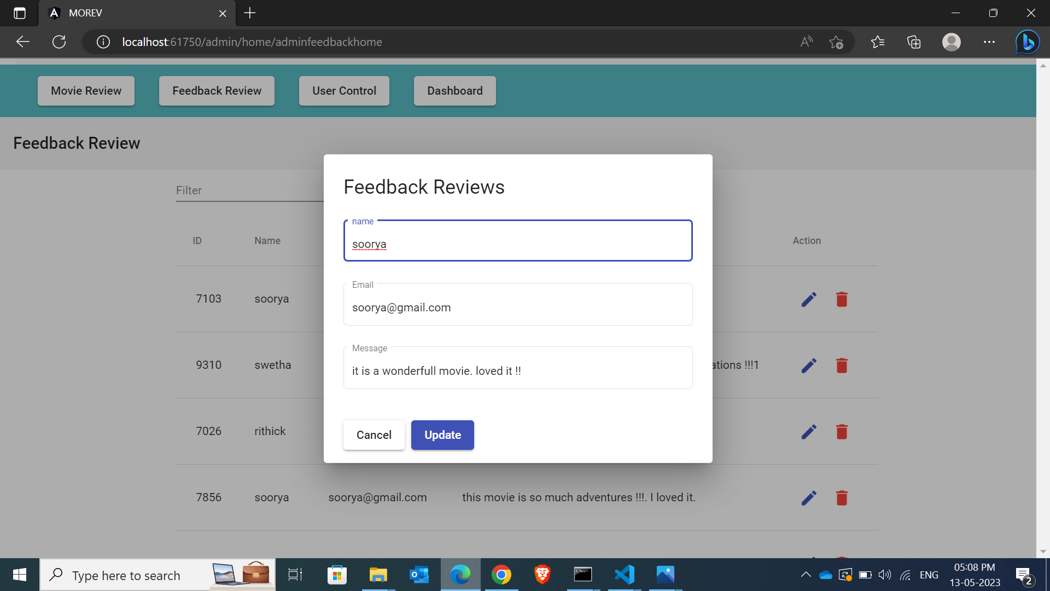
Concepts implemented
Table
Service
Navigation
Filter
Here the admin can edit the feedbacks given by the users on any movie

Slide 14
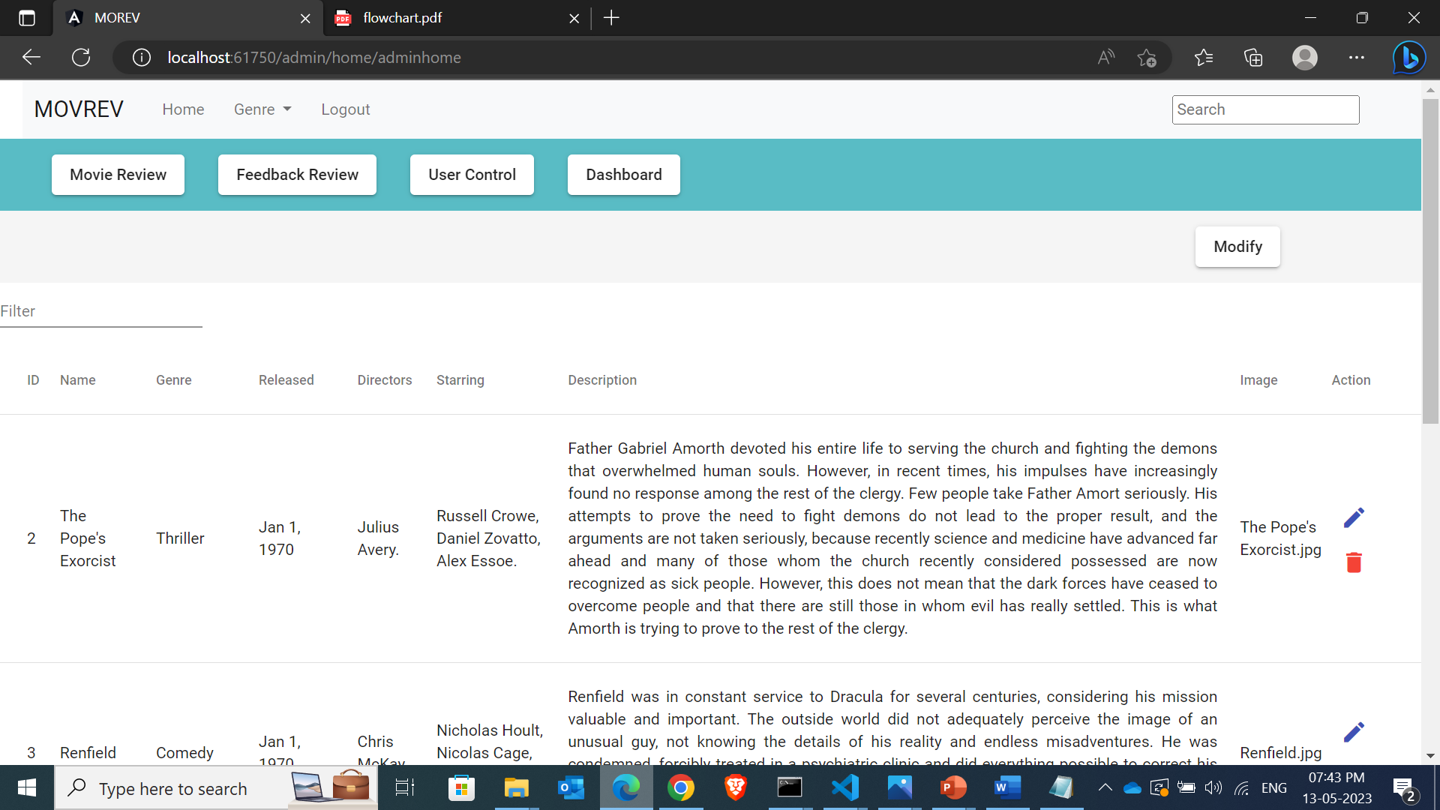
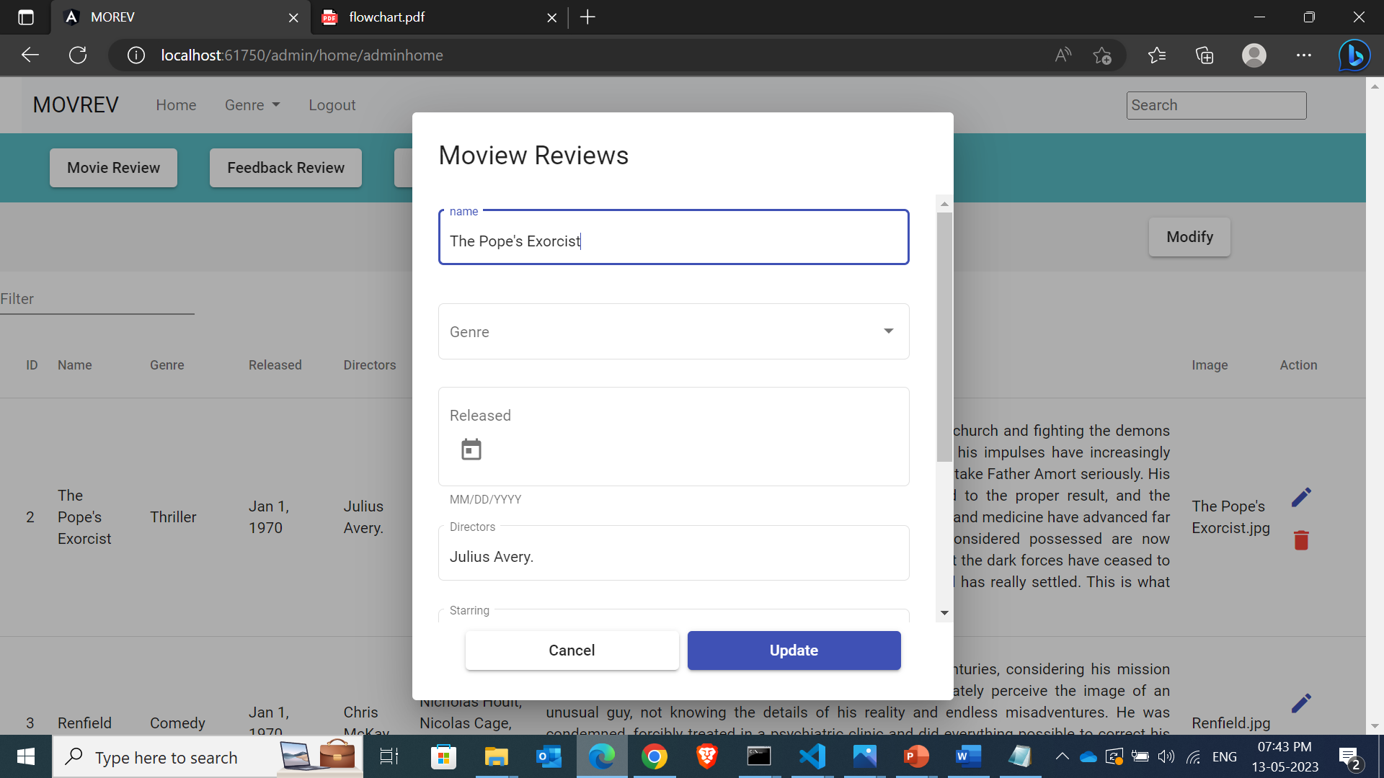

Concepts
implemented
Table
Service
Navigation
Filter
Here the admin can edit the movie details .the admin can perform CRUD operation here.

Slide 15
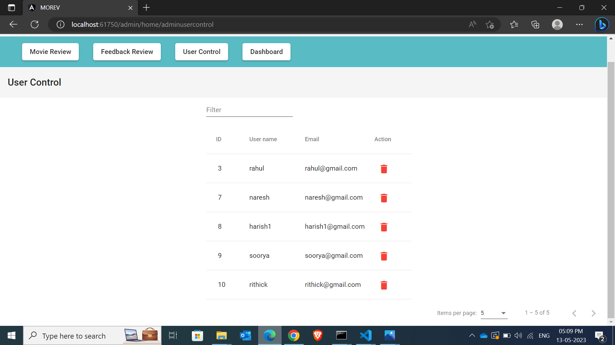
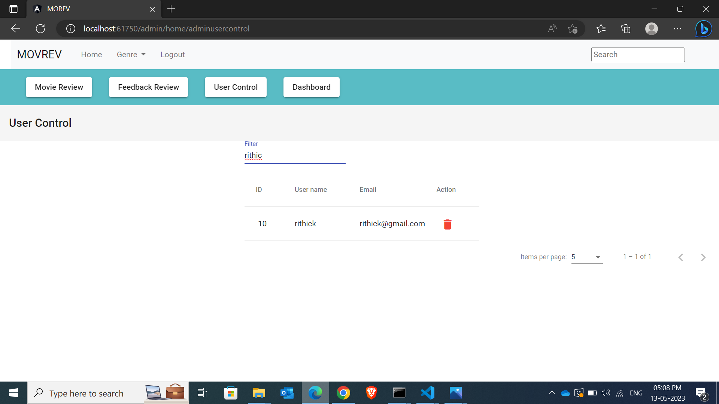
Concepts
implemented
Table
Service
Navigation
Filter
Here the admin can delete the user from the json. The admin can also search for a user.

Slide 16
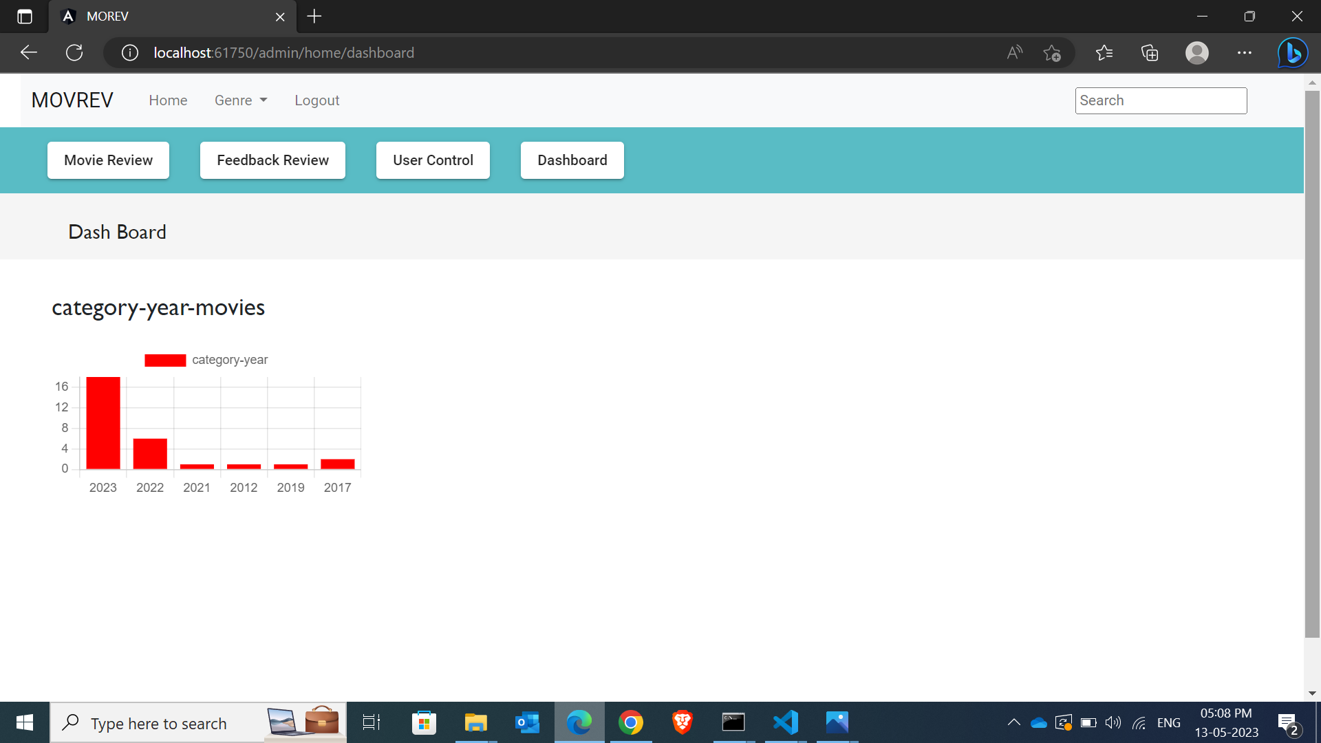
Concepts
implemented
Service
json
Navigation
chart
Here the admin can see the graph representing the movie released annually in the website (not hard coded , the data is fetched from json server)

Slide 17
Thank you

